Slide 1
IPL PERFORMANCE ANALYSIS

Slide 2
Introduction
The Indian Premier League (IPL) is one of the most popular and competitive T20 cricket leagues in the world, known for its thrilling matches, star players, and massive fan base. This project analyzes historical IPL match data to uncover meaningful patterns, performance trends, and predictive insights using Machine Learning techniques.
Project Focus Areas:
📊Trends and patterns across IPL seasons
🏏Team and player performance metrics
🏟️Impact of toss, venue, and match conditions on results
💡Insights derived through Exploratory Data Analysis (EDA), Visualization and Machine Learning

Slide 3
Data Collection
📂Source of Data: The dataset used in this project was collected from publicly available IPL match records, primarily sourced from:
🔗Kaggle: IPL Complete Dataset (2008-2024)
📊Dataset Details:
📅 Seasons: 2008 to 2024
🏏 Matches: Over 1095 matches
📈 Format: CSV files containing structured match-level data

Slide 4
Data Preprocessing
🧩Handling Missing Values:
Filled missing entries in columns like method, target_runs, and result_margin with default values.
🧹Data Cleaning & Standardization:
Fixed inconsistent team names (e.g., Delhi Daredevils → Delhi Capitals)
Renamed columns for clarity
⚙️Feature Engineering
Created season column from year
Added match_time (Afternoon/Evening) based on duplicate dates

Slide 5
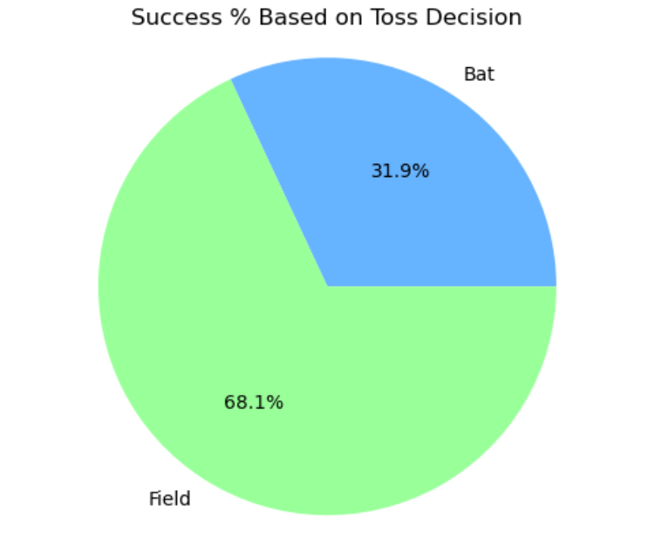
Exploratory Data Analysis (EDA)
📅 Season-Based Trends
Total matches per season (2008–2024)
🏆 Team Performance
Most successful teams based on total wins
🪙 Toss Impact
Analyzed how toss decisions (bat/field) affect winning probability
Teams fielding first win ~68% of matches
🏟️ Venue Analysis
Wankhede, Eden Gardens and Chinnaswamy among most frequent host venues
👑 Player Insights
Top “Player of the Match” award winners identified

Slide 6
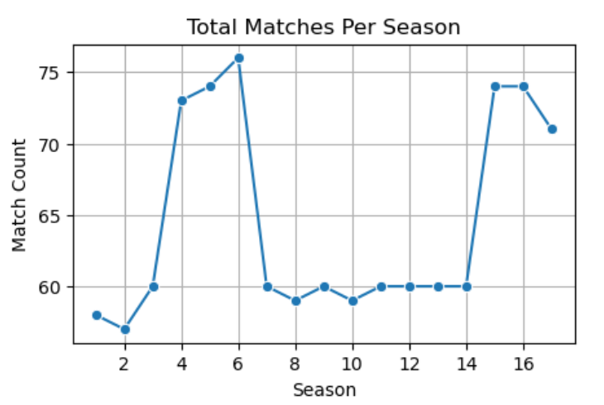
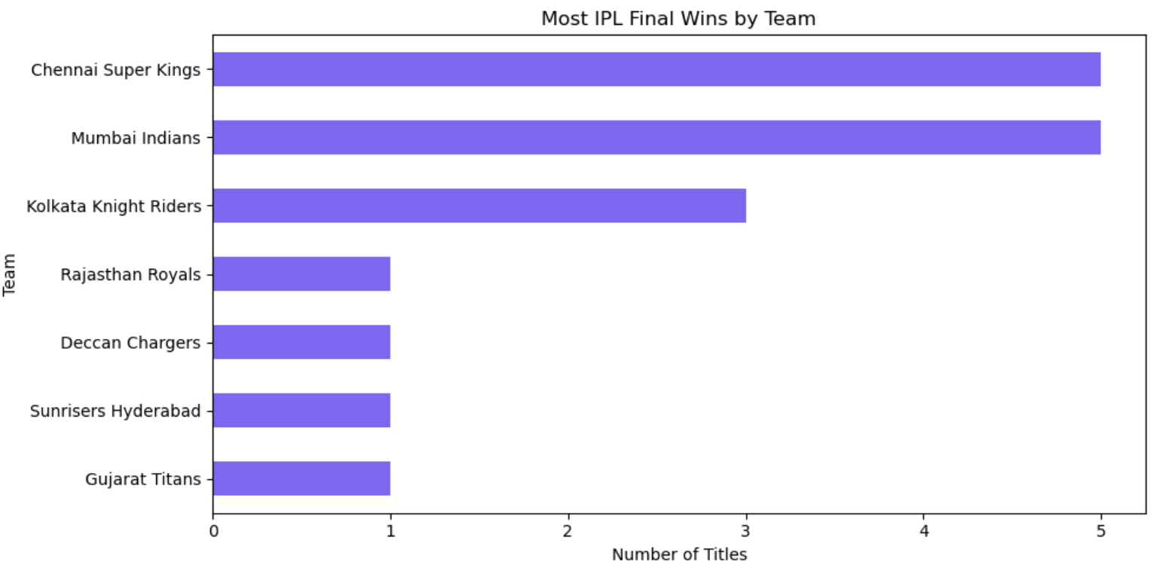
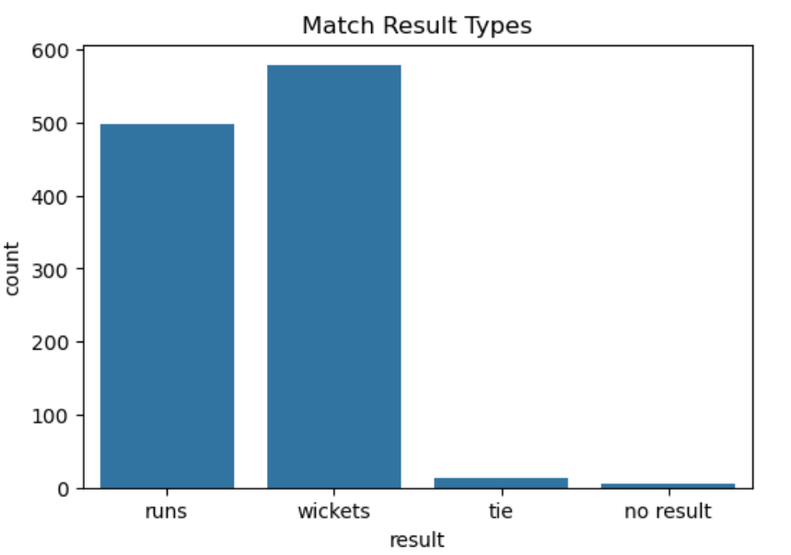
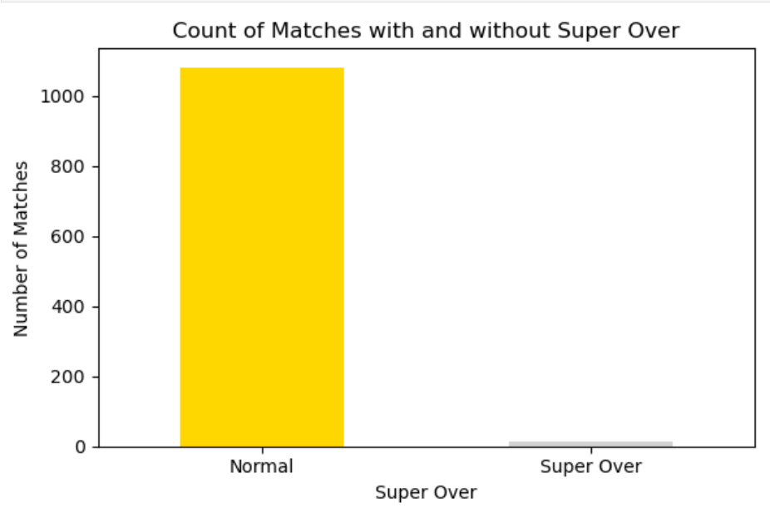
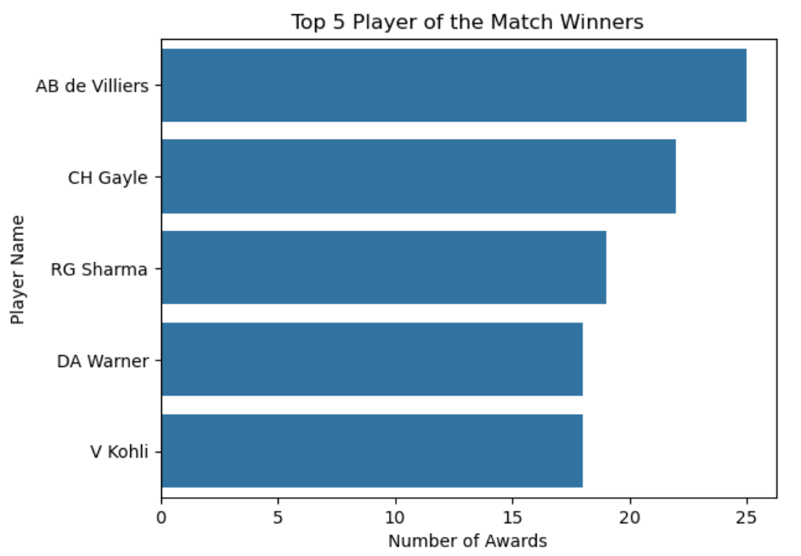
Data Visualization

Slide 7
Machine Learning Overview
Machine Learning (ML) enables systems to identify patterns from data and make intelligent predictions.
In this project, ML is used to predict the winning IPL team based on historical match data (2008–2024).
A Supervised Classification Model is applied to predict outcomes using match-related features.
The chosen algorithm — Random Forest Classifier — provides high accuracy and interpretability for categorical data.

Slide 8
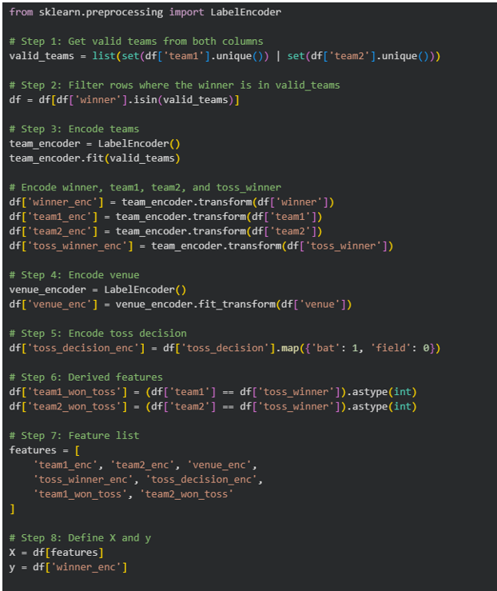
Feature Encoding & Data Transformation
To prepare categorical data for ML modeling, Label Encoding
from sklearn.preprocessing was applied.
Encoded Columns:
team1, team2, winner, toss_winner, venue
Mapped Feature:
toss_decision → {'bat': 1, 'field': 0}

Slide 9
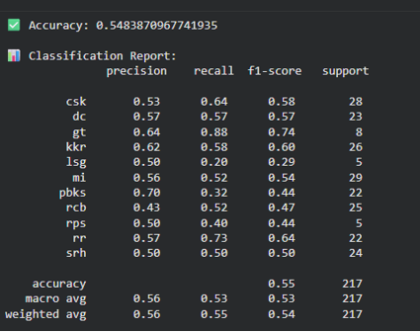
Model Evaluation & Performance Metrics
Evaluated using:
🎯 Accuracy Score: Percentage of correctly predicted outcomes
🔢 Confusion Matrix: Shows correct vs. incorrect team predictions
📋 Classification Report: Precision, recall & F1-score of model
Model Summary:
Algorithm: Random Forest Classifier
Accuracy: ~65%
Insights:
Moderate performance due to match unpredictability
Team, venue & toss features moderately influence outcomes

Slide 10
Key Insights & Findings
📊 From Data Analysis (EDA)
IPL matches increased steadily (2008–2024) with new teams and venues.
Teams fielding first won about 68% of matches → chasing advantage.
Mumbai Indians (MI) & Chennai Super Kings (CSK) emerged as the most consistent teams.
Venues like Wankhede and Eden Gardens hosted most matches & often favored chasing sides.
Top players: AB de Villiers, Chris Gayle, Rohit Sharma lead Player of the Match awards.
🤖 From Machine Learning Model
Algorithm: Random Forest Classifier
Accuracy: ~65%
Key Influencing Features: Toss Decision, Venue, and Teams
Moderate accuracy due to cricket’s unpredictable nature, but reveals strategic patterns behind outcomes.

Slide 11
Challenges & Solutions
⚙️ Challenges
Missing & inconsistent data
Team name variations (Delhi Daredevils → Delhi Capitals)
Handling multiple categorical features
Data imbalance among teams
💡 Solutions
Cleaned & standardized dataset
Applied Label Encoding for categorical data
Used Random Forest for better performance
Added new features (toss_won, match_time)
Evaluated using Accuracy, Precision, and F1-score

Slide 12
Conclusion & Future Scope
✅ Conclusion
Analyzed 1,095 IPL matches (2008–2024) using Python & ML.
Discovered key performance patterns through EDA.
Built a Random Forest model with ~65% accuracy.
Showed how data analytics can extract insights from sports data.
🚀 Future Scope
Add player-level data for deeper predictions.
Test advanced models (XGBoost, Neural Networks).
Create a real-time IPL analytics dashboard.

Slide 13
THANK YOU

